Slide 1
Title of the Project
Group Number - Student Name, Student Name, Student Name,
Introduction to Data Science
M.Tech Data Science and Engineering – Cluster Batch 4
dd-mmm-yyyy

Slide 2
Overview
Objective – Due to the rise and rapid growth of E-Commerce, use of credit cards for online purchases has dramatically increased. As credit card becomes the most popular mode of payment for both online as well as regular purchase, cases of fraud associated with it are also rising. Detecting fraud transactions is of great importance for any credit card company since it’s important that credit card companies can recognize fraudulent credit card transactions so that customers are not charged for items that they did not purchase. The techniques applied here on one such dataset can help classify such fraudulent transactions
Methodology - We started with the basic understanding of data provided to us namely statistical and visual aspects. After applying feature engineering techniques such as scaling and normalization, we have implemented different classifiers using Decision Tree, Naïve Bayes and Logistic Regression approaches and compared their accuracies.
Dataset
How many features – The data set has 30 features (class column not included here – can discuss further)
Size of the dataset – The data set has 284807 entries and total size is 67.4 MB.
Multiple files – The data set doesn’t have multiple files.
What kind of data – The data is numerical where most of the features have went through the PCA transformation except two namely ‘Time’ and ‘Amount’.
Balanced or imbalanced – The data set is highly imbalanced as there are 282493 non-fraudulent transactions and 460 fraudulent transactions. The same can also be viewed visually
Distribution of Training set, validation set, testing set
Missing data and Preprocessing challenges

Slide 3
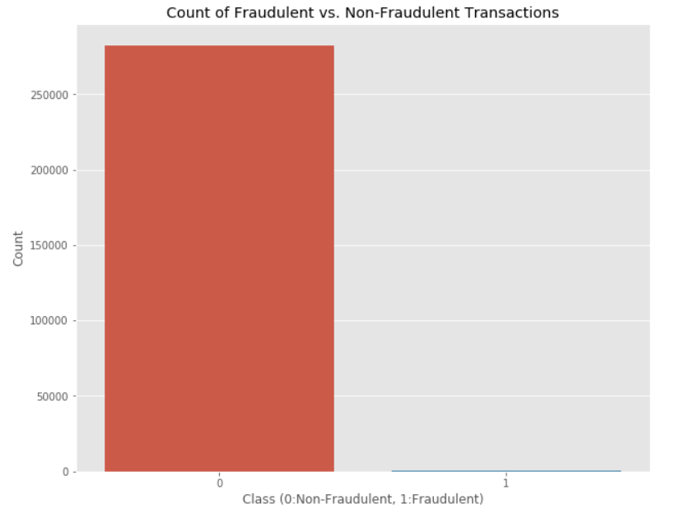
Dataset
How many features – The data set has 30 features (class column not included here – can discuss further)
Size of the dataset – The data set has 284807 entries and total size is 67.4 MB.
Multiple files – The data set doesn’t have multiple files.
What kind of data – The data is numerical where most of the features have went through the PCA transformation except two namely ‘Time’ and ‘Amount’.
Balanced or imbalanced – The data set is highly imbalanced as there are 282493 non-fraudulent transactions and 460 fraudulent transactions. The same can also be viewed visually
Distribution of Training set, validation set, testing set – Need to discuss this
Missing data and Preprocessing challenges – The challenge of missing data was not there and the only preprocessing required on the data was removing duplicate rows.

Slide 4
Methodology
The 3 classifiers used – The classifiers used in this task are :
1) Decision Tree
2) Naïve Bayes
3) Logistic Regression
Ensemble pipeline
Other models considered
Hyper-parameter tuning

Slide 5
Feature Engineering Techniques
Features removed -
Feature creation – Description of only two features is provided and other feature names’ have been masked due to privacy concerns, so new features can’t be created.
Feature ranking
Class imbalance treatment – Since the quantity of non fraudulent transactions is very high as compared to fraudulent transactions, so sampling original data and creating a new sub-sample has been performed. We have randomly taken 460 cases of non-fraud (to match fraud cases) to create our new sub data frame.
Any other

Slide 6
Results
Table for the evaluation metric for each ML technique used
Plot of the curves
Conclusion

